Slide 1
S1 Computing Science

Slide 2
micro:bit

Slide 3
Morse Code

Slide 4
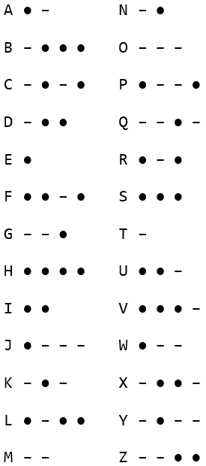
Morse Code
Letters encoded as dots and dashes
E is a single dot: ●
Y is dash dot dash dash : – ● – –
Letters that are used lots are shorter
Can be sent as sound, light, electricity
20
10
5
🚢
Notes:
words per minute (wpm): Hello
Titanic: https://www.youtube.com/watch?v=TzUet_MLh8Q

Slide 5
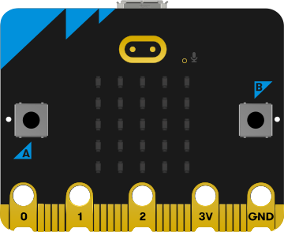

micro:bit Morse
Notes:
Task: https://mrfriendcs.github.io/s1/S1-SDD-Morse/

Slide 6
Brevity Codes
A short code that means something longer
LOL
SOS
QRV
ZEV
Battle Code (BATCO) – British Army
- Laugh Out Loud
- Save Our Souls
- Q Code: Are you ready?
- Z Code: Request you acknowledge message
Notes:
SOS was picked as easy to be use, not because it meant anything.
https://en.wikipedia.org/wiki/Q_code
https://en.wikipedia.org/wiki/BATCO
https://www.idahoares.info/_downloads/articles/DigitalComms/ACP131F09%20Operating%20(Z%20and%20Q)%20Signals.pdf

Slide 7
Q Codes
Signal | Question | Answer, Advice or Order
QEA | May I cross the runway ahead of you? | You may cross the runway ahead of me.
QOD | Can you communicate with me in... 0. Dutch 1. English 2. French 3. German? | I can you communicate with you in... 0. Dutch 1. English 2. French 3. German?
QUS | Have you sighted survivors or wreckage? | Have sighted... 1) survivors in water, 2) survivors on rafts, 3) wreckage
Notes:
Make own brevity codes – English / Gàidhlig

Slide 8
iDEA Award

Slide 9
Bronze Award
Award: 250 points
Citizen: 50 points
Worker: 50 points
Maker: 50 points
Entrepreneur: 50 points
Notes:
C.7Fbe4MCp8H=x!

Slide 10
Sign Up (1)
Website: idea.org.uk
Glow email: es<username>@glow.sch.uk
Group code: S1_2024-25
Nickname: es<username>
Save login details in personal OneNote

Slide 11
Sign Up (2)
Recovery email: No
Email updates: No
Group code: S1_2024-25
Guardian's name: Mr Friend
Guardian's email: esafriend1r@glow.sch.uk
Use parent's details, if email known

